Slide 1




Connecting the dots in Lightning with ‘Influence Map’
Mohammed Rizwan
Senior Salesforce Developer
Standav Digital

Slide 2
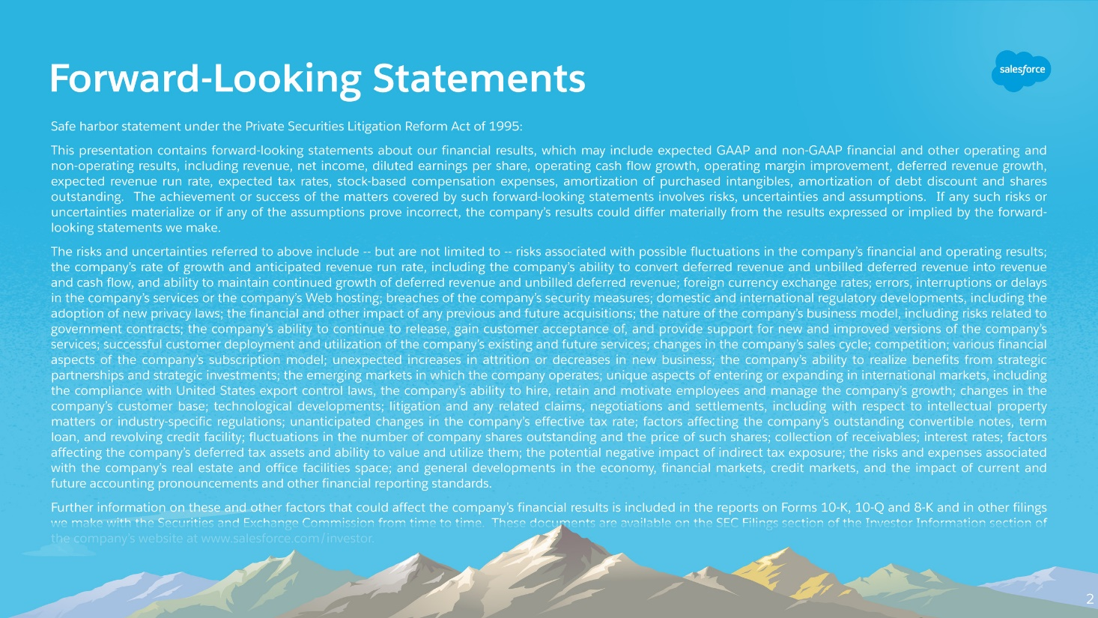

Slide 3
Agenda
Use Case
Building Blocks
Code Sample
Demo
Q&A

Slide 4
Use Case
A successful Sales needs collaboration of people across business verticals
People are directly and indirectly related to multiple organisations
These people may positively or negatively effective a business deal
Vital for a company to know Influencers and Blockers and map out what sort of Influence they may have in a business deal
Get people involved and win more deals

Slide 5
Building Blocks
Custom Object(s)
Custom Metadata
Apex Classes
Lightning Components
Test Classes

Slide 6
Code Sample

Slide 7
Demo

Slide 8



Q&A
For more info:
@rizwanakhtar08
/mritizi/IndiaDreamIn18
contact@mdrizwan.com

Slide 9


